Slide 1
LWC Training
Use Components in Salesforce Experiences
May 10, 2019
Day 4: Use Components in Salesforce Experiences

Slide 2
Agenda
agenda
Use Components in SF Experience
Navigate to Pages, Records, Lists
Aura Coexistence
Composition of LWC

Slide 3
Use Components in Salesforce Experiences

Slide 4
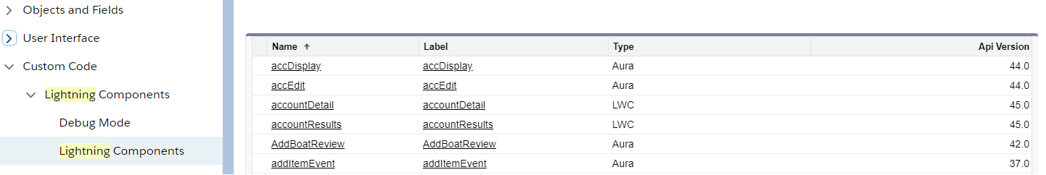
View Components in Setup
Use components in salesforce experiences
LWC is available from version 45.0
Source of Components are not visible in Salesforce.
It appear under Lightning Components Section with the type “LWC”.
Development is done on local and migrated through Salesforce CLI
Setup

Slide 5
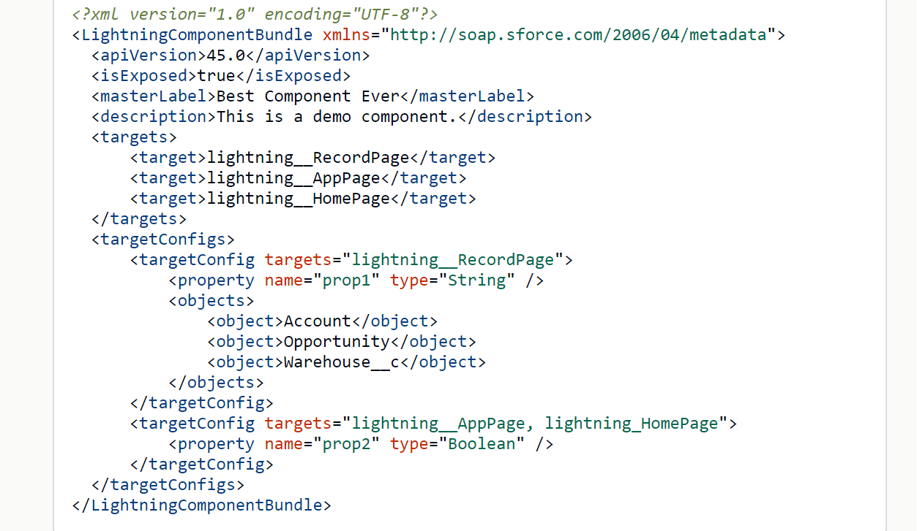
Lightning App Builder
Use components in salesforce experiences
Steps required to use you custom lightning web components in Lightning App Builder :
Deploy My Domain in your org
Define Component Metadata in the Configuration File
Optional: Add an SVG Resource to Your Component Bundle
Set isExposed to true.
Mention target.
Mention targetConfigs.
Configure component’s properties
Set supported objects

Slide 6
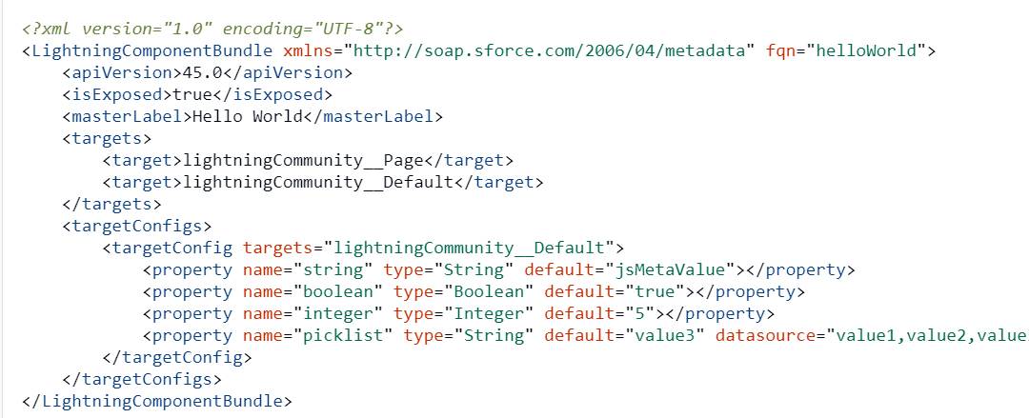
Community Builder
Use components in salesforce experiences
To configure a component for lightning communities :
Define Component Metadata in the Configuration File.
Define the component’s design configuration values.
Optional: Add an SVG Resource to Your Component Bundle.
Set isExposed to true.
Define lightningCommunity__Page in targets.
Define lightningCommunity__Default in targets and define the properties in targetConfigs.

Slide 7
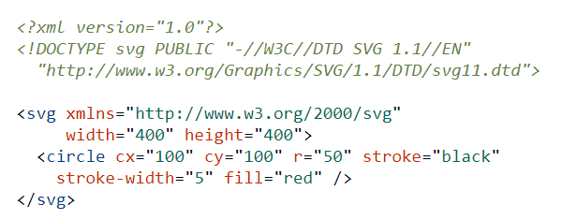
Adding a SVG to Components
Use components in salesforce experiences
Use of CSS or Lightning Design System to design Lightning Components:
To define a custom icon for your component, add an SVG resource to your component’s folder. If there is no SVG resource, the system uses a default lightning icon.
An SVG resource must be named component.svg. You can only have one SVG per folder.

Slide 8
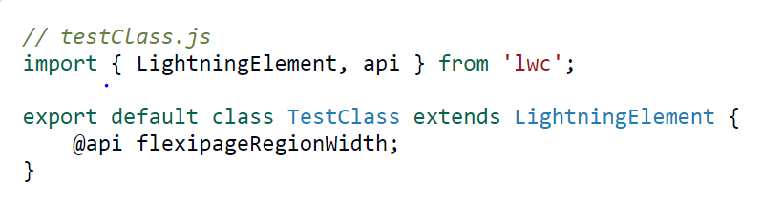
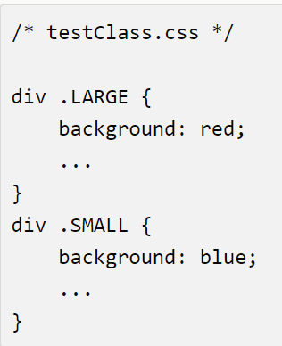

Make a Component Width-Aware
Use components in salesforce experiences
Add flexipageRegionWidth with some strategic CSS, the component renders in different ways in different regions at run time.
Use @api decorator to create a public flexipageRegionWidth property.
Use the flexipageRegionWidth property in the HTML template. Component rerenders, when value of flexipageRegionWidth changes.
Valid CSS class values are SMALL, MEDIUM, and LARGE.

Slide 9
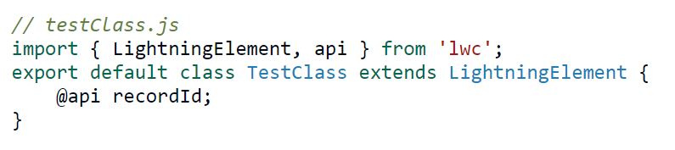
Make a Component Aware of Its Record Context
Use components in salesforce experiences
If a component is used on a Lightning record page, the ID of the current record can be passed into the component.
Use the @api decorator to create a public recordId property.
recordId is set to the 18-character ID of the record.
recordId holds Id of current record.

Slide 10
Make a Component Aware of Its Object Context
Use components in salesforce experiences
When a component is used on a lightning record page, the API name of the object related to the record can be passed to the component.
In Javascript, the decorator @api is used to create a public objectApiName property.
For Example: For Opportunity record page being viewed :
//componentAwareOfObjectContext.js
import { LightningElement, api } from 'lwc’;
export default class componentAwareOfObjectContext extends LightningElement {
@api objectApiName; // Value assigned in this case would be “Opportunity”
}

Slide 11
Navigate to Pages, Records and Lists

Slide 12
Navigate to Pages, Records and Lists
Navigate to pages, records and lists
To navigate in Lightning Experience, Lightning Communities and in Salesforce app, use navigation service (lightning/navigation).
Instead of URL, the navigation service uses a page reference.
Used to navigate to different page types, Tabs, Object, List View, Related list and Aura components.
Page Reference
PageRefrence is a javascript object that describes the page type, its attributes, and the state of the page.
Using a PageReference insulates the component from future changes to URL formats.
It also allows the component to be used in multiple applications.

Slide 13
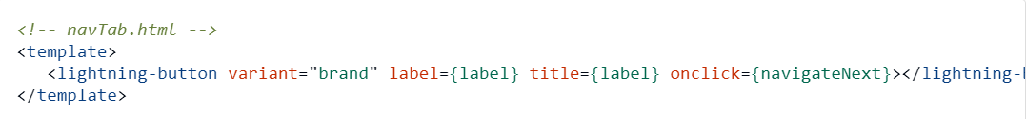
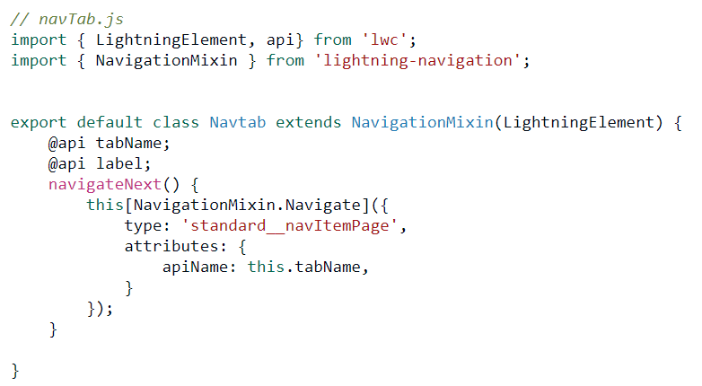
Navigate to Pages, Records and Lists
Navigate to pages, records and lists
Import lightning-navigation for using navigation service.
Define type that determine the use this component.
Define attributes that determine the target page.
Define state to conditionally customize content.

Slide 14
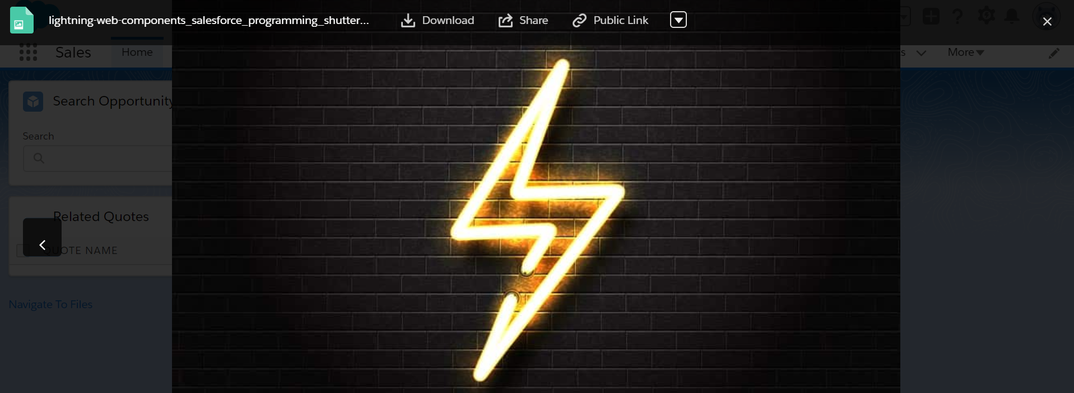
Open Files
Navigate to pages, records and lists
This is used for opening one or more file records in Lightning Experience and Salesforce Apps.
It use the navigation service, lightning/navigation.
It supports the ContentDocument and ContentHubItem (external files) objects.
Example

Slide 15
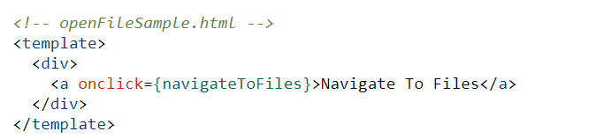
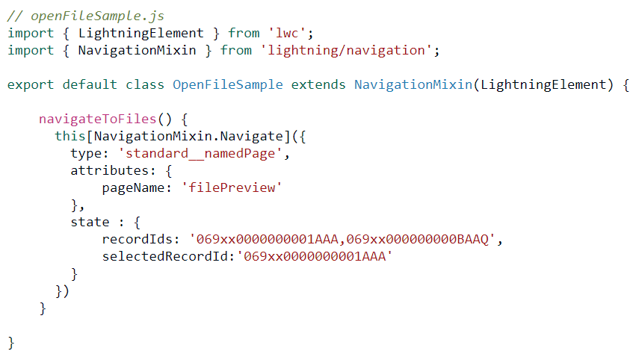
Open Files Example
Navigate to pages, records and lists
navigateToFiles method is called in a href tag.
Required parameter for showing files (content documents).
Multiple files can be included comma separated.

Slide 16
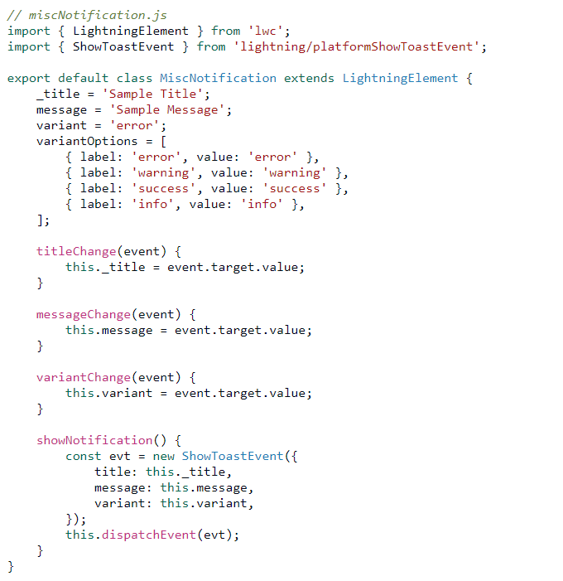
Display a Toast Notification
Navigate to pages, records and lists
Import ShowToastEvent from lightning/platformShowToastEvent.
Create and dispatch a ShowToastEvent event with title, message, variant and mode properties.
lightning/platformShowToastEvent is imported.
Dispatching event

Slide 17
Aura Coexistence

Slide 18
Aura Coexistence
Aura coexistence
An interoperability layer enables Lightning web components and Aura components to work together in an app.
Lightning web components can be add to apps that contain Aura components.
Lightning web components and Aura components can work together, but there are limitations to it.
Aura components can contain Lightning web components. However, the opposite doesn’t apply. Lightning web components can’t contain Aura components.

Slide 19
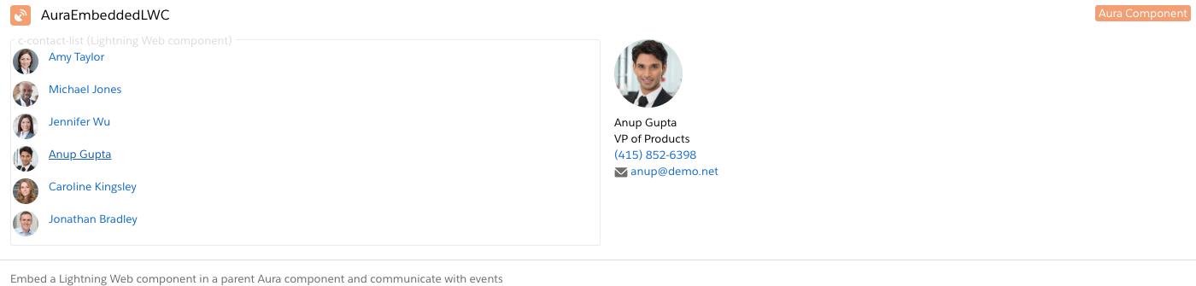
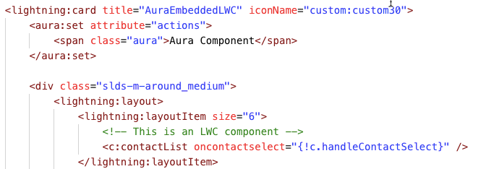
LWC Component inside Aura Component
Aura coexistence
Example: Rendered LWC component inside Aura Component
Including LWC in Aura component

Slide 20
Composition of LWC

Slide 21
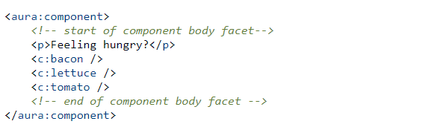
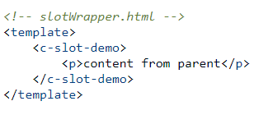
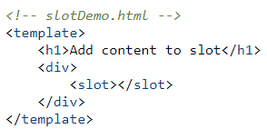
Composition of LWC
Composition of lwc
Facets and Slots :
In Aura components and Lightning web components, we can add components into the body of another component. In Aura, you add components into facets. In Lightning web components, you add components into slots.
In Aura, the body attribute is a facet. A facet is any attribute of type Aura.Component[], which is just a fancy way of saying you can set an array of components for the attribute.
A slot is a placeholder for markup that a parent component passes into a component’s body.
Facets
Unnamed Slot
Named Slot

Slide 22
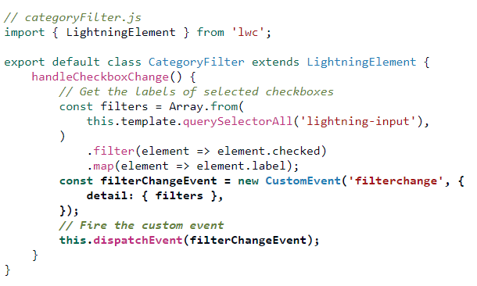
Events
Composition of lwC
To communicate from child to parent, dispatch an event. Lightning web components fire DOM events.
The enclosing Aura component can capture the event and handle it. Optionally, the Aura component can fire an Aura event to communicate with other Aura components or with the app container
The Lightning web component fires a custom filter change event in its JavaScript file
Defining and dispatching events in LWC

Slide 23
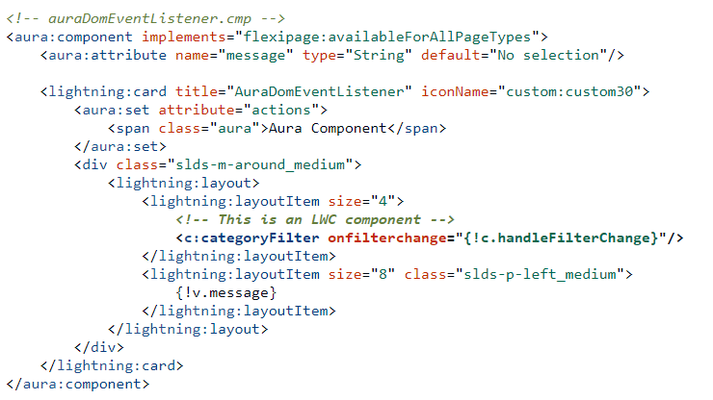
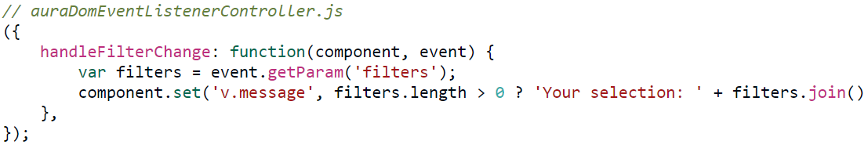
Events handling in Aura Component
Composition of lwC
The enclosing Aura component wrapper adds a handler for the custom event.
Defining handler in Aura component
Receiving and handling events in Aura controller

Slide 24
Questions

Slide 25
1.which of the following is true.
LWC is available from version 44.0
Source of Components are not visible in Salesforce.
It appear under Lightning Components Section with the type “LWC”.
B and c.
2. which prpopety is used to Make a Component Width-Aware.
@track
@api
flexipageRegionWidth
All of the above.
3.which service is used to navigate in Lightning Experience, Lightning Communities and in Salesforce app Instead of URL, the navigation service uses a page reference.
navigation service (lightning/navigation).
force:navigateToURL
Non of the above
All of the above

Slide 26
Hands on Challenge

Slide 27
Navigation Component
Hands on challenge
Use Case
Create “NavigationCombo” Lightning Web Component with five buttons named as Home tab, Create New Account, Lead List View, Navigate to Opportunity, View Chatter Home. Home tab button should navigate to Home page, Create New Account button should navigate to new account page, Lead List View button should navigate to the list view of lead object, Navigate to Opporunity button should navigate to any of opportunity record detail page and View Chatter Home button will navigate to chatter.
Create “FlexibleComponent” Lightning Web Component which will show ten contact records. Create an Application Page in the App Builder with “header & two Regions” and add this component in header section of this page. Now, move this component to other section of this page. This component should be flexible with the width of the different sections.

